Slide 1

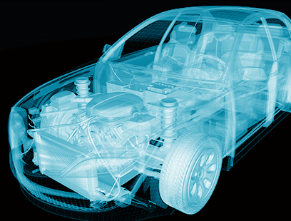




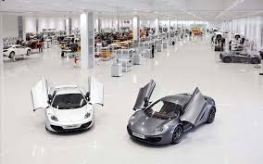

Nexar Reviewers Support Analysis
Date: 23-Apr-2021
Focus-Innovate-Expand & Differentiate

Slide 2
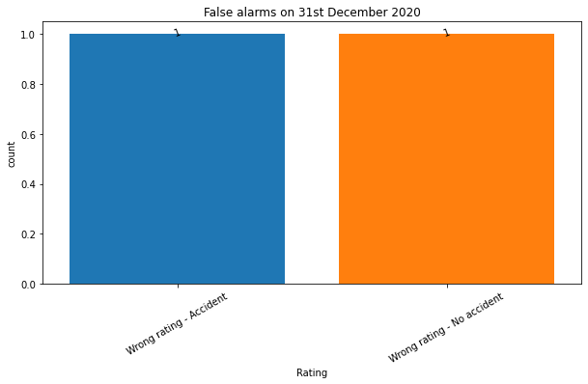
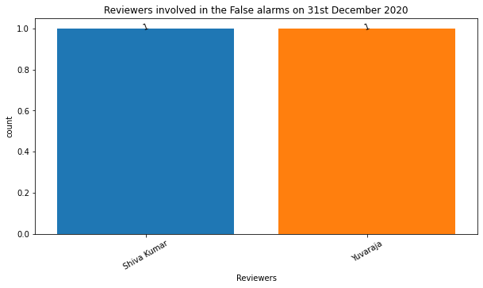
False Alarms on 31st December 2020 and Reviewers involved
False Alarms
Reviewers

Slide 3
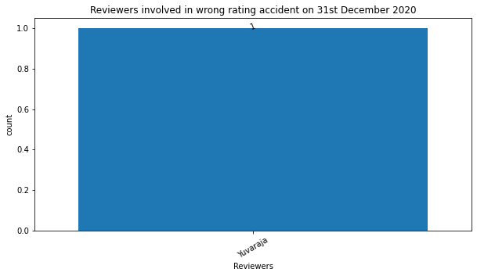
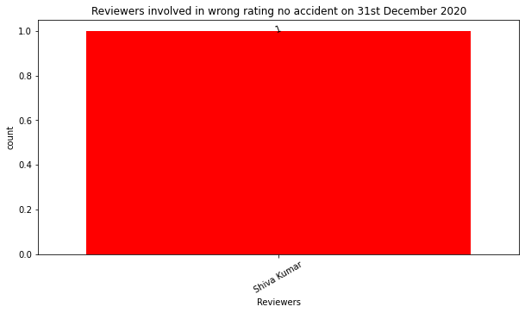
Different kinds of false alarms generated on 31st December 2020
Wrong Rating – Accident
Wrong Rating – No Accident

Slide 4
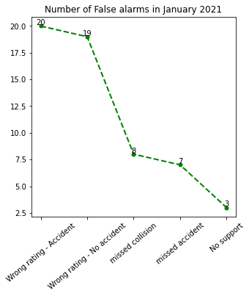
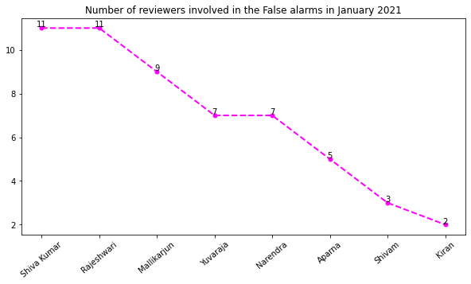
False Alarms in January 2021 and Reviewers involved
False Alarms
Reviewers

Slide 5
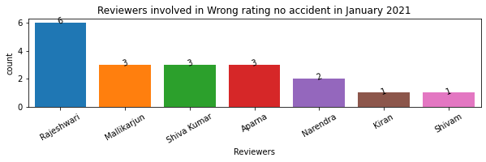
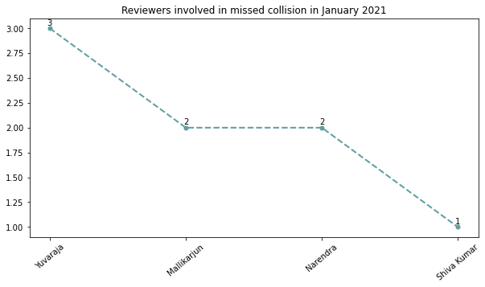
Different kinds of false alarms generated in January 2021
Wrong Rating – No Accident
Missed Collision

Slide 6
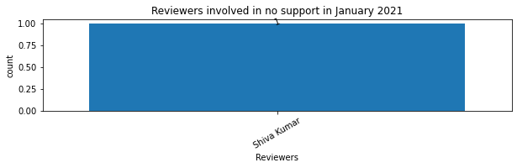
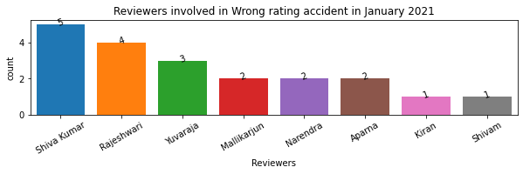
No Support
Wrong Rating - Accident

Slide 7
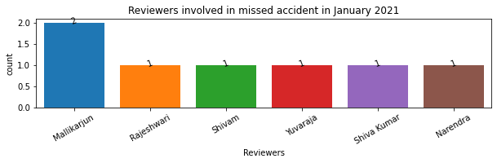
Missed Accident

Slide 8
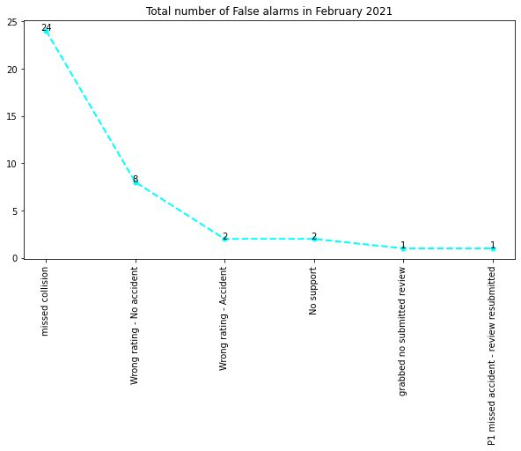
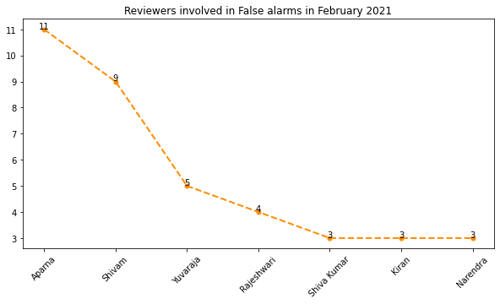
False Alarms in February 2021 and Reviewers involved
False Alarms
Reviewers

Slide 9
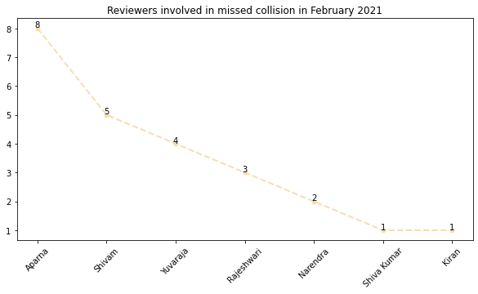
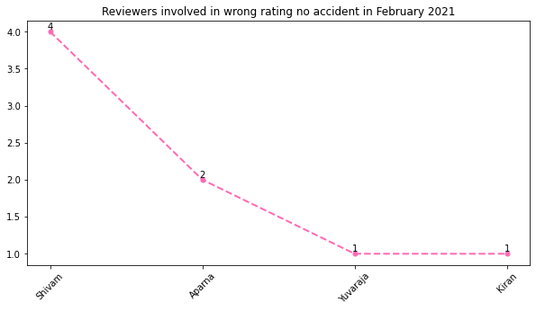
Different kinds of false alarms generated in February 2021
Missed Collision
Wrong Rating – No Accident

Slide 10
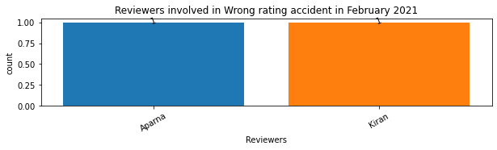
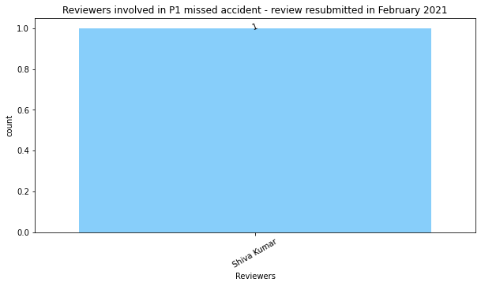
Wrong Rating – Accident
P1 missed Accident – Review Submitted

Slide 11
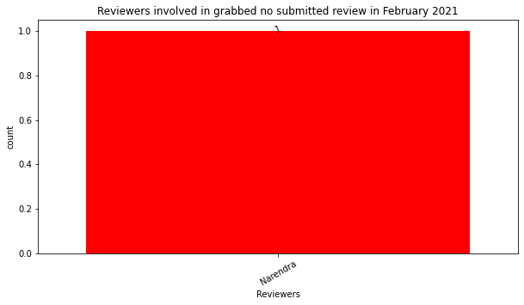
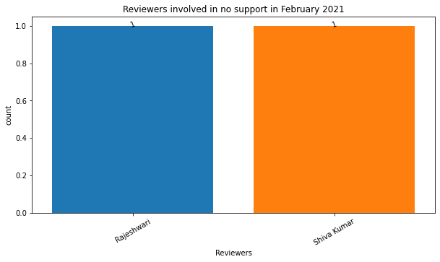
Grabbed No Submitted Review
No Support

Slide 12
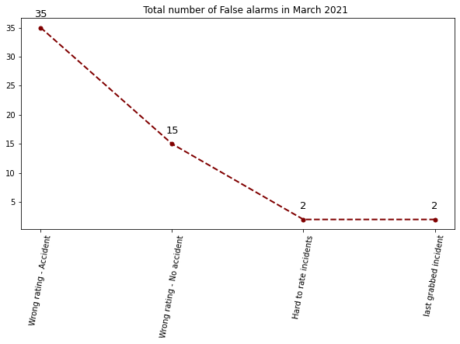
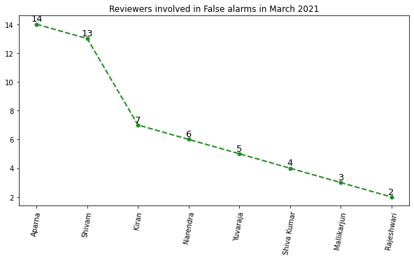
False Alarms in March 2021 and Reviewers involved
False Alarms
Reviewers

Slide 13
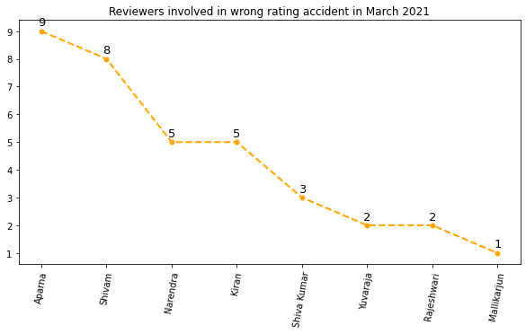
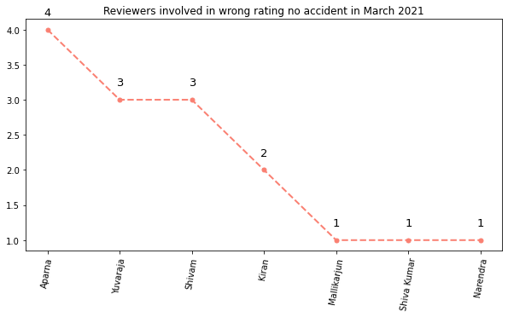
Different kinds of false alarms generated in March 2021
Wrong Rating - Accident
Wrong Rating - No Accident

Slide 14
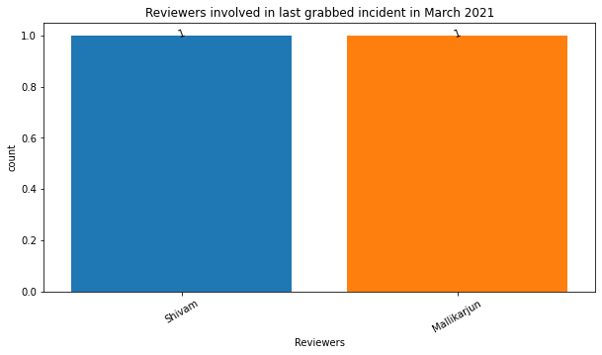
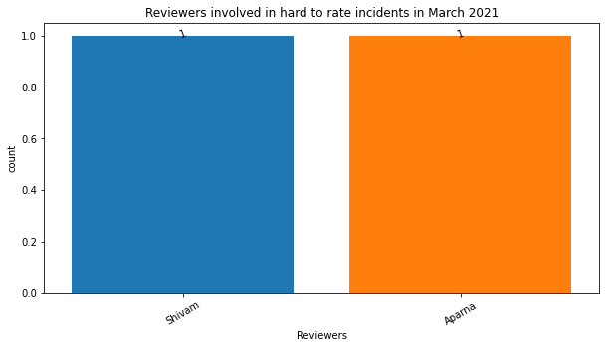
Last Grabbed Incident
Hard to Rate Incident

Slide 15
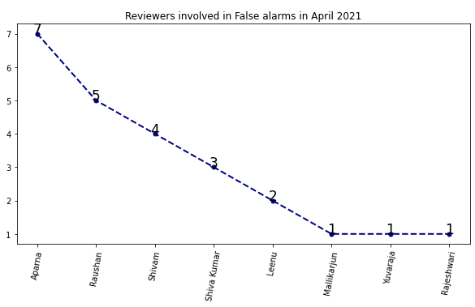
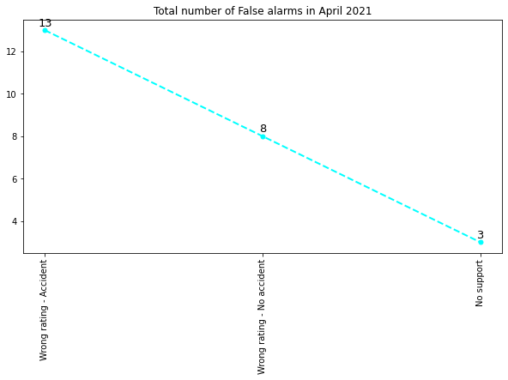
False Alarms in April 2021 and Reviewers involved
False Alarms
Reviewers

Slide 16
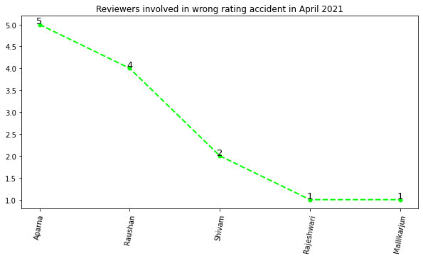
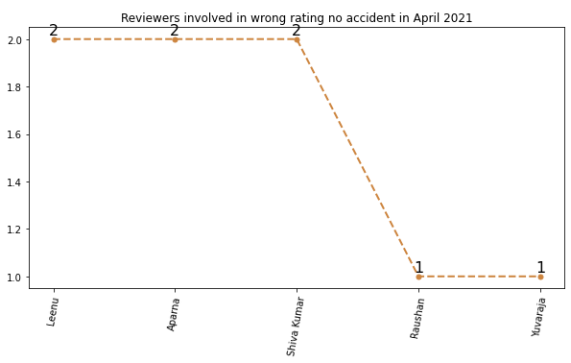
Different kinds of false alarms generated in April 2021
Wrong Rating - Accident
Wrong Rating – No Accident

Slide 17
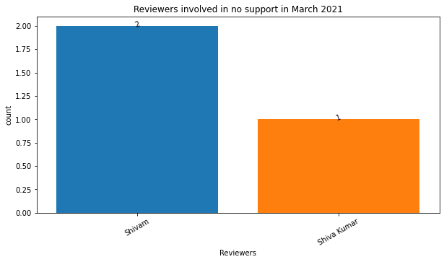
No Support

Slide 18
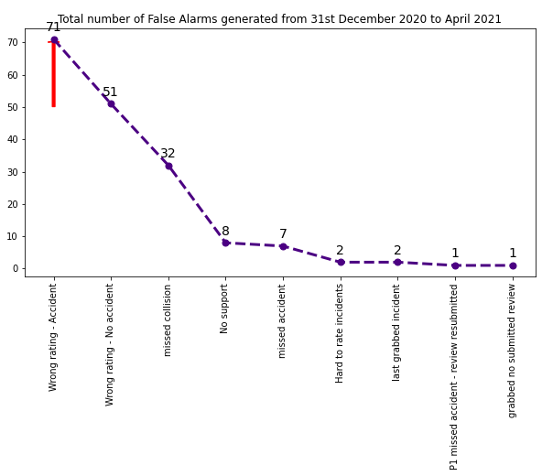
Total Analysis of Ratings and Remarks

Slide 19
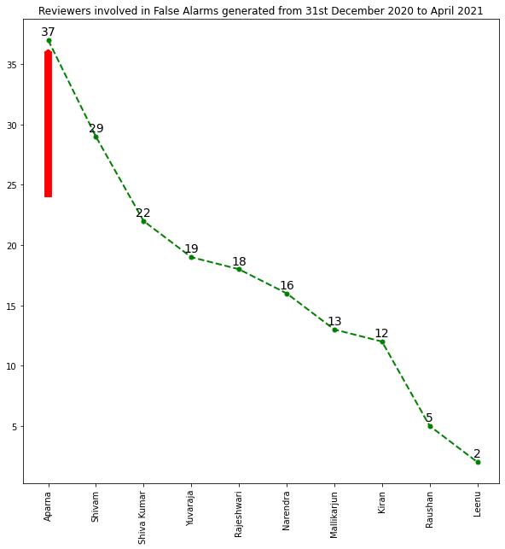
Total Analysis of Reviewers

Slide 20
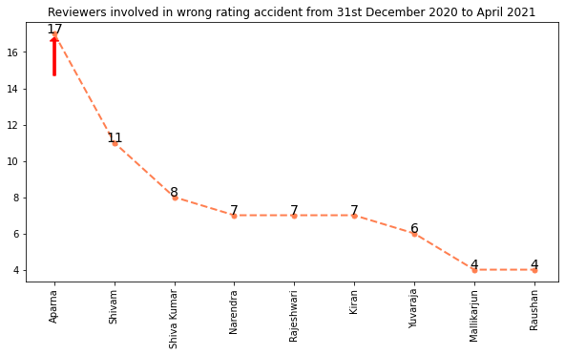
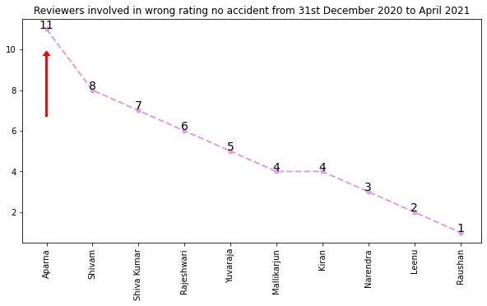
Total Analysis of Different Kinds of False Alarms
Wrong Rating - Accident
Wrong Rating – No Accident

Slide 21
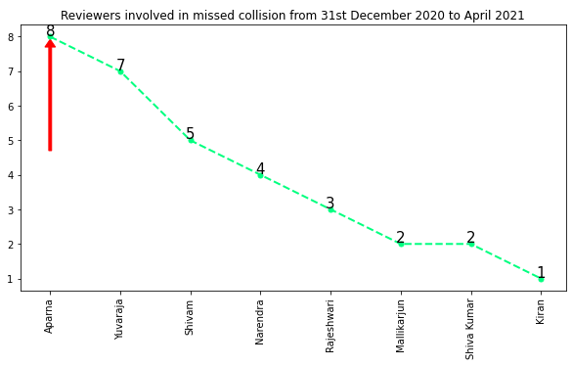
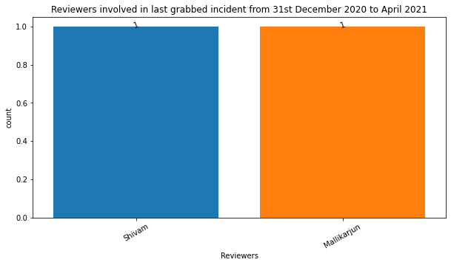
Missed Collision
Last Grabbed Incident

Slide 22
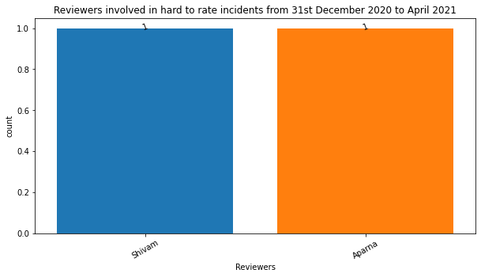
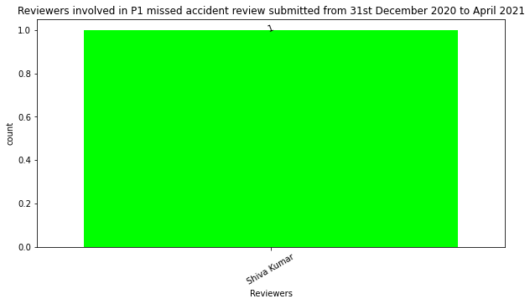
Hard to Rate Incident
P1 Missed Accident - Review Submitted

Slide 23
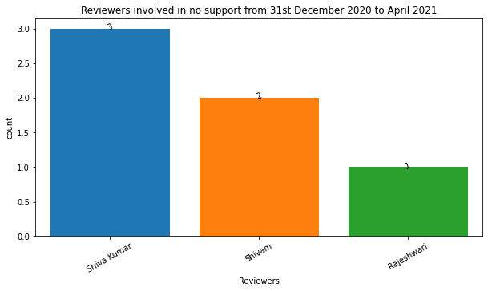
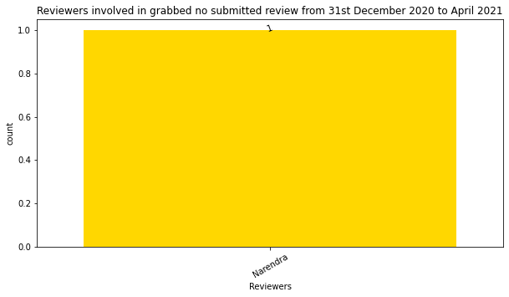
No Support
Grabbed No Submitted Review

Slide 24
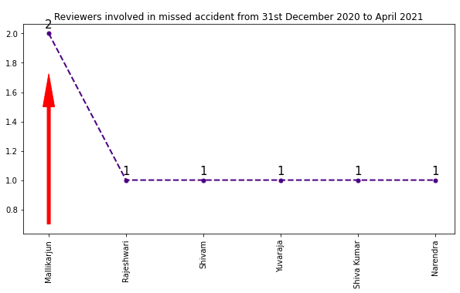
Missed Accident

Slide 25
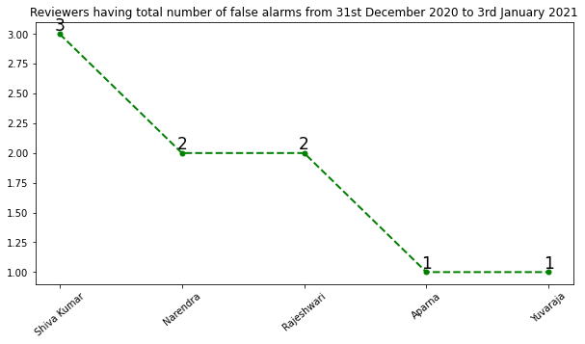
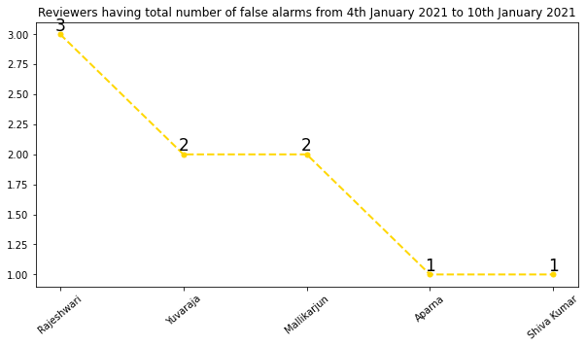
Weekly Basis Report for Reviewers involved in the False Alarms
Last week of December 2020 - January 2021 from 31.12.2020 - 03.01.2021
1st week January 2021 from 04.01.2021 - 10.01.2021

Slide 26
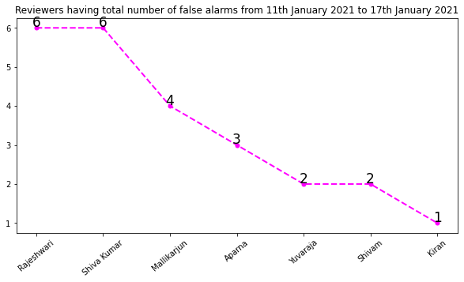
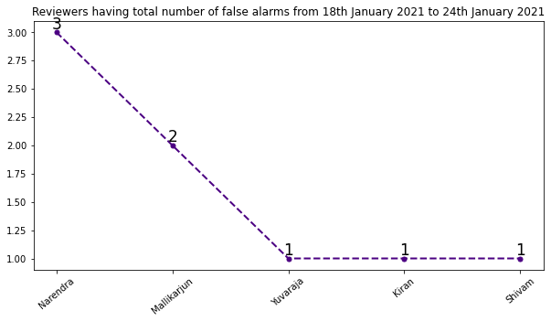
2nd week January 2021 from 11.01.2021 - 17.01.2021
3rd week January 2021 from 18.01.2021 - 24.01.2021

Slide 27
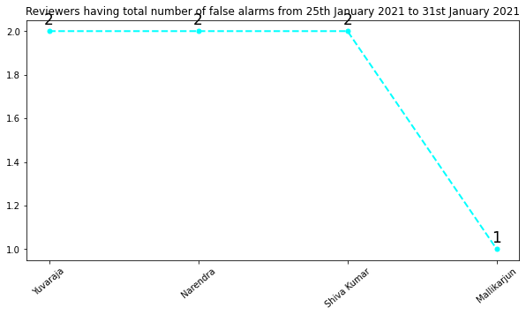
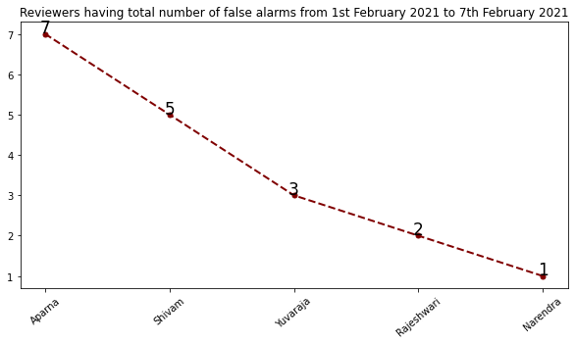
Last week January 2021 from 25.01.2021 - 31.01.2021
1st week February 2021 from 01.02.2021 - 07.02.2021

Slide 28
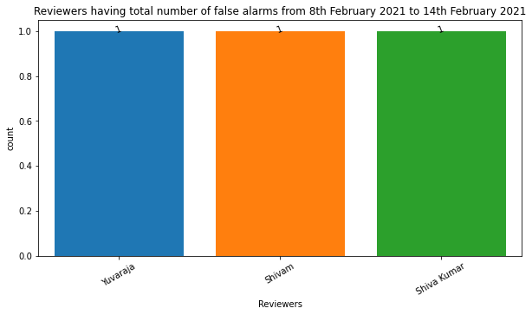

2nd week February 2021 from 08.02.2021 - 14.02.2021
3rd week February 2021 from 15.02.2021 - 21.02.2021

Slide 29


Last week February 2021 from 22.02.2021 - 28.02.2021
1st week March 2021 from 01.03.2021 - 07.03.2021

Slide 30


2nd week March 2021 from 08.03.2021 - 14.03.2021
3rd week March 2021 from 15.03.2021 - 21.03.2021

Slide 31


4th week March 2021 from 22.03.2021 - 28.03.2021
Last week of March 2021 - April 2021 from 29.03.2021 - 04.04.2021

Slide 32


1st week April 2021 from 05.04.2021 - 11.04.2021
2nd week April 2021 from 12.04.2021 - 17.04.2021

Slide 33


Monthly Basis Report for Reviewers involved in the False Alarms
31st December 2020
January 2021

Slide 34


February 2021
March 2021

Slide 35

April 2021

Slide 36
Thank you

